Slide 1
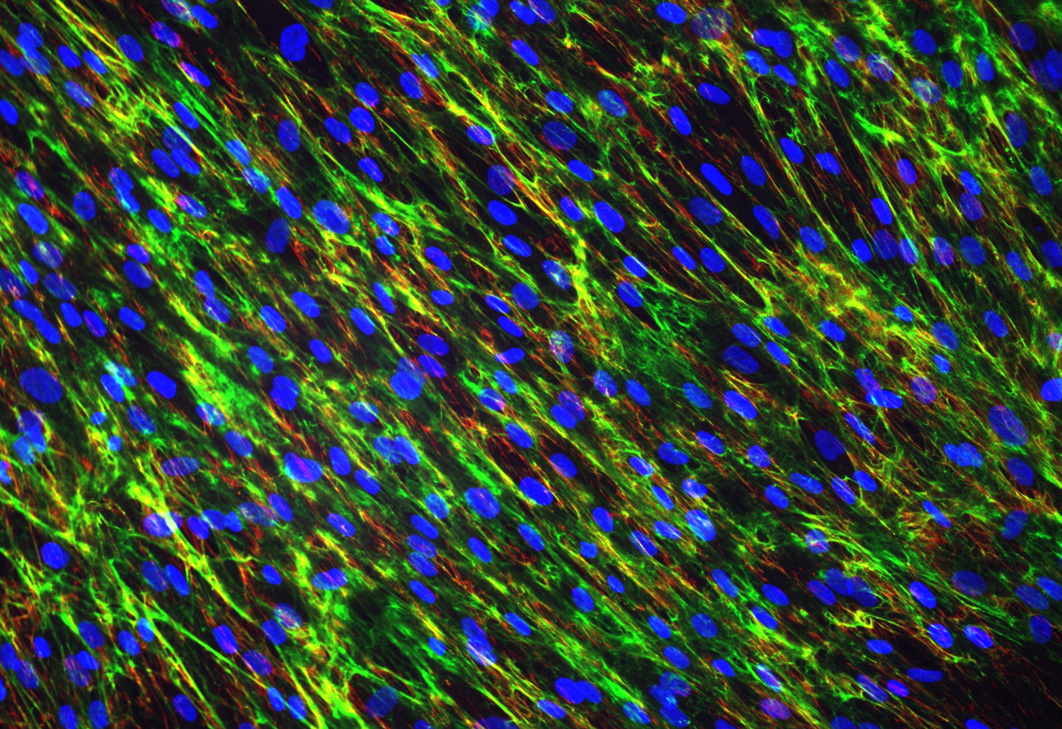
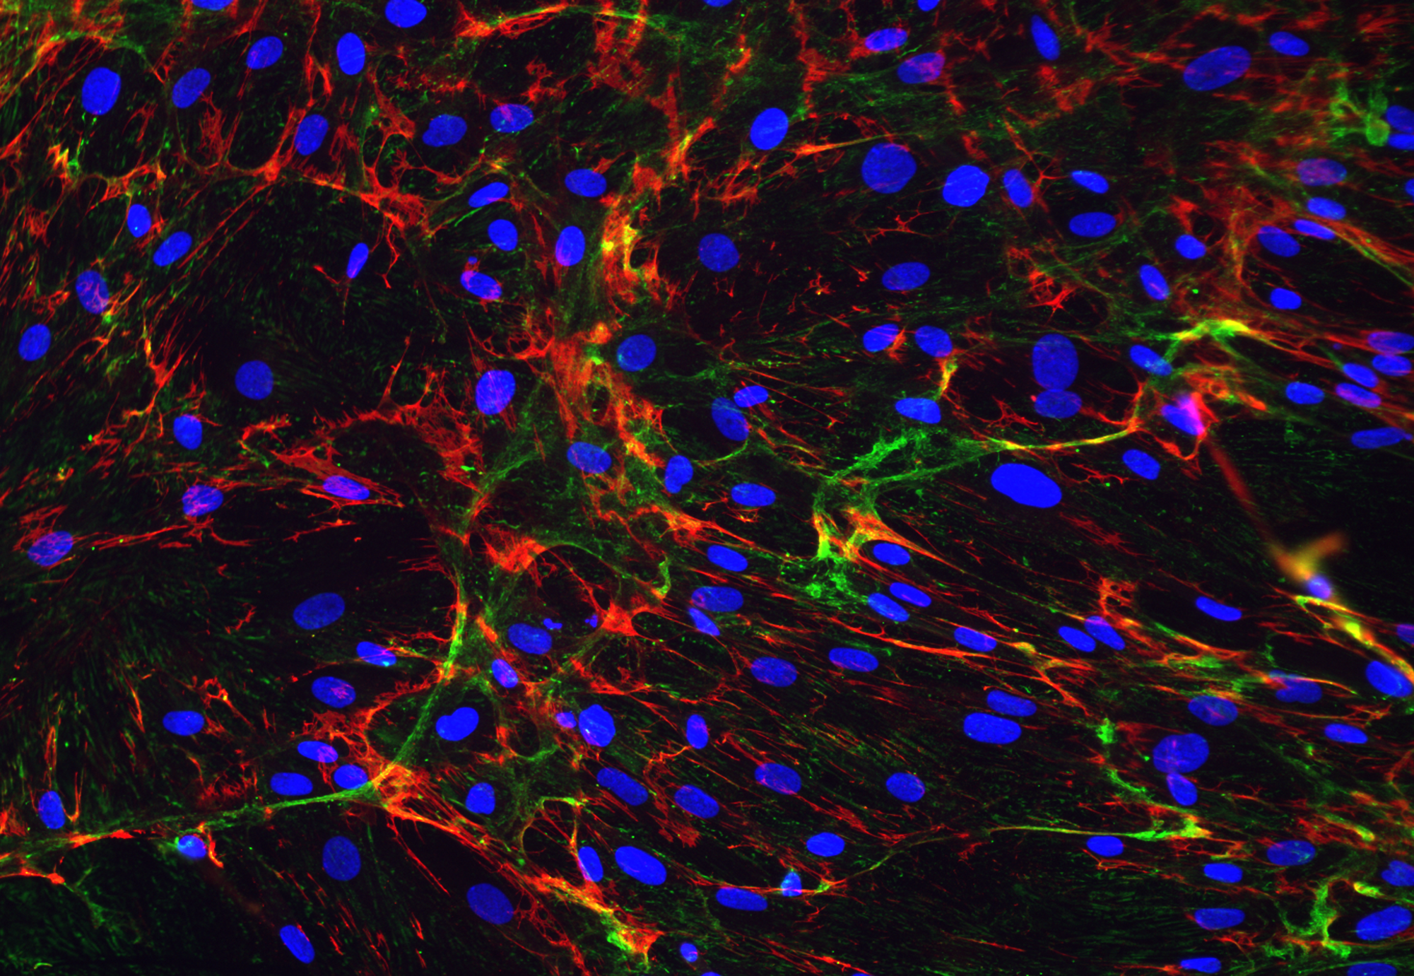
Col6/Fibronectin/DAPI
ICG
ICG
L6509 fibroblasts, wild type
L9476 fibroblasts, Col6A2 G283E mutant (heterozygous)

